Slide 1
The wardens
Angel Alvarado #133537
Abdiel Centeno #144970
Bryan Lopez #137857
Juan pabon #130781

Slide 2
Intro
Have you ever wondered “Where can I store important information safely?”. Well, we got the solution for you. Introducing databases, a software that is able to save information without loosing it later on. In the following slides we will show you just how you can use it to your advantage.

Slide 3



The Wardens
Introducing The Wardens.
The Wardens is a software that uses databases to store people’s personal information.
In this version we use a prison and its prisoners as an example.

Slide 4
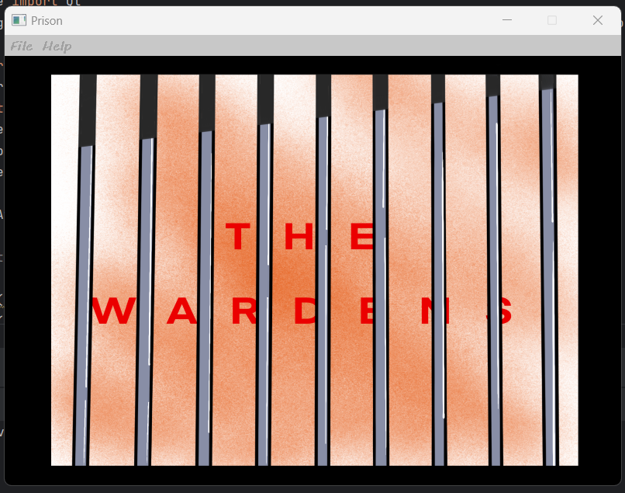
Main menu
Welcome to the main menu, this is the first thing that you will see once you open the app. Here you will see different options like:
File
Help

Slide 5
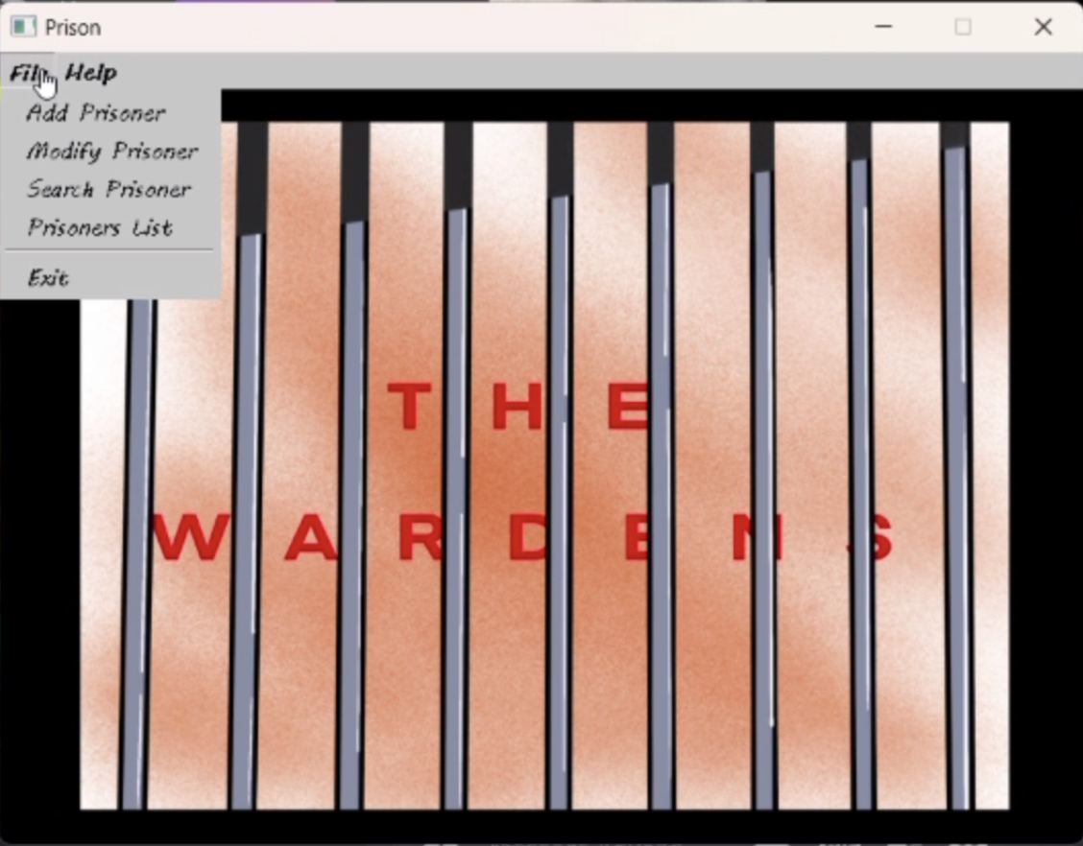
File
Inside of this option you can find things like:
Add Prisoner
Modify Prisoner
Search Prisoner
Prisoners list
Exit

Slide 6
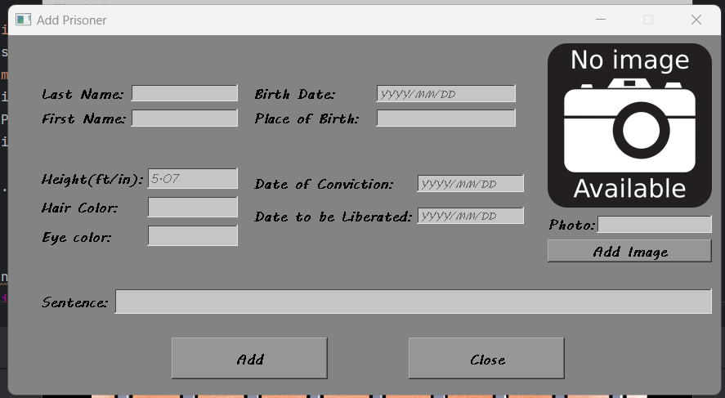
Add Prisoner
After you click on the ‘Add Prisoner’ option, you will be taken to this screen where you will be able to enter all the information. Once you are done click on the ‘Add’ button to confirm the information.

Slide 7
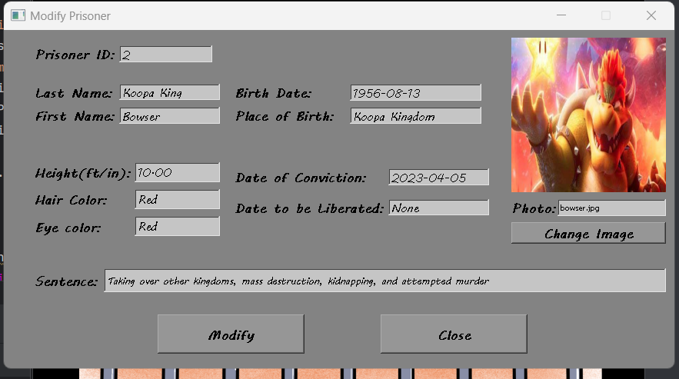
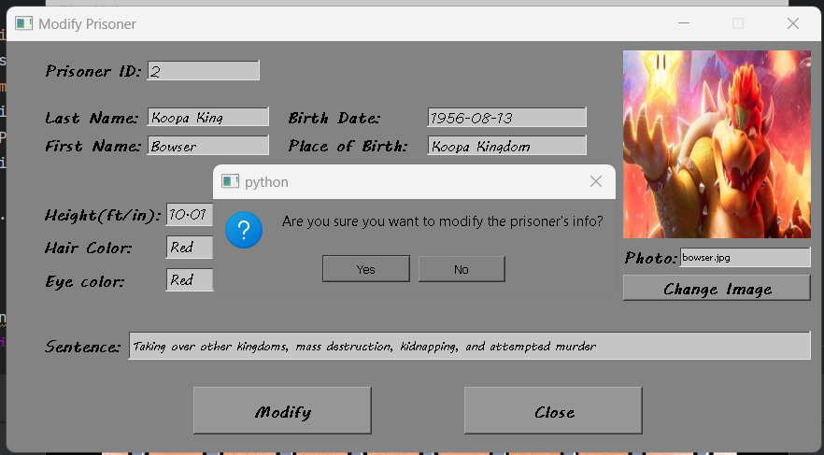
Modify
The same goes for the modify option. After you have successfully entered the information, you will get a confirmation pop up.
Your screen should look like the image shown here.

Slide 8
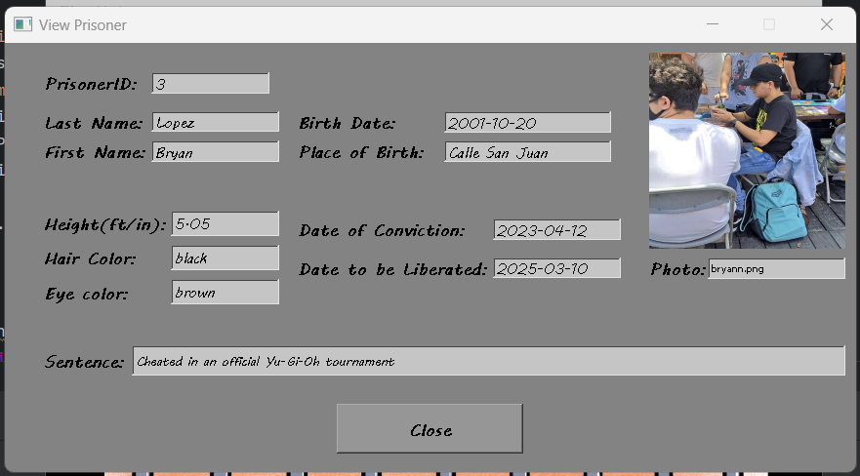
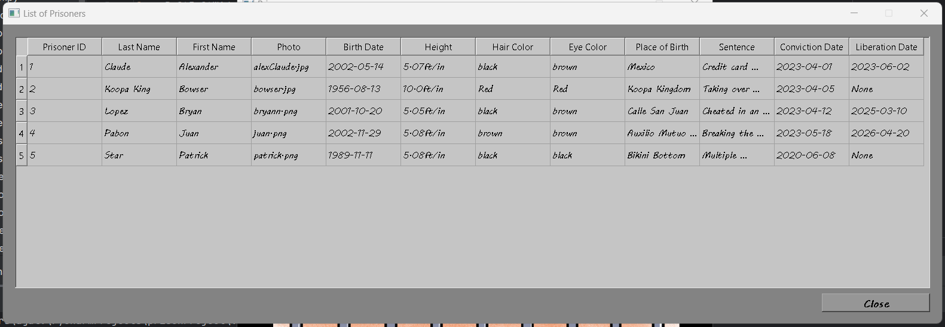
View and search
If you ever wish to view a prisoner's information, you can always click on the ‘view’ option and enter the prisoner’s ID to search for them.
If you do not remember the prisoner’s ID for some reason, you can also click on the ‘List of Prisoners’ option to look at all the prisoners and their overall information, including the ID.

Slide 9
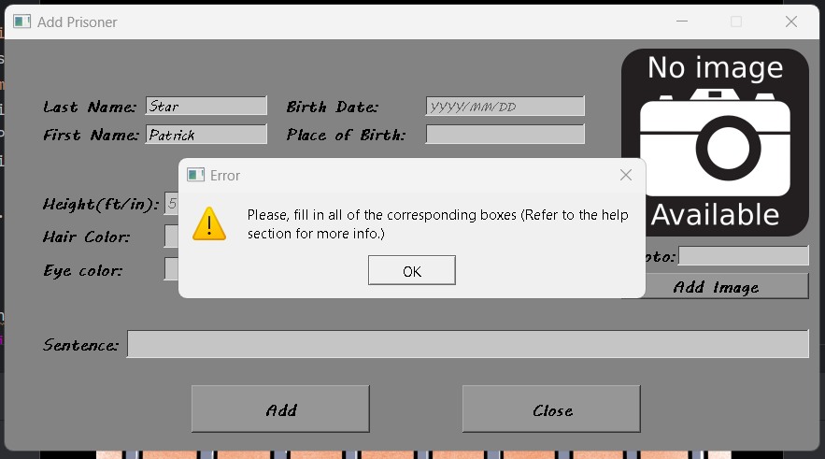
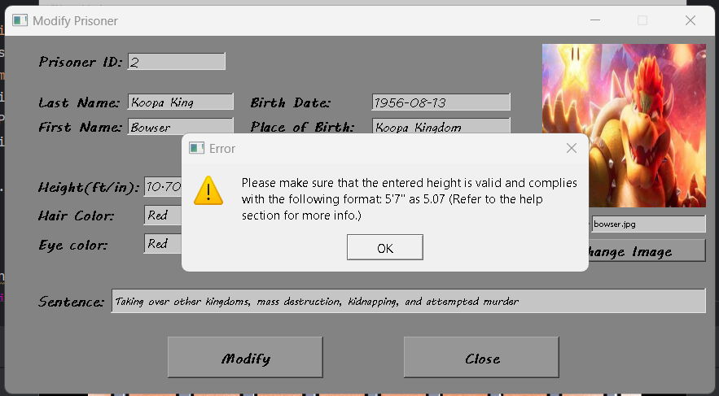
Errors
Of course, if you enter invalid information or leave a box empty, you will always get an error message, so make sure that you enter all the information correctly.

Slide 10
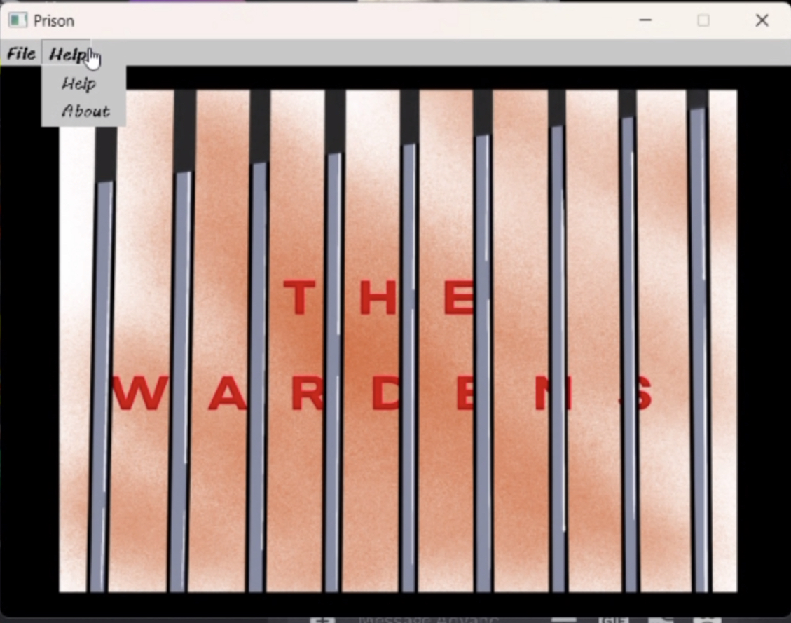
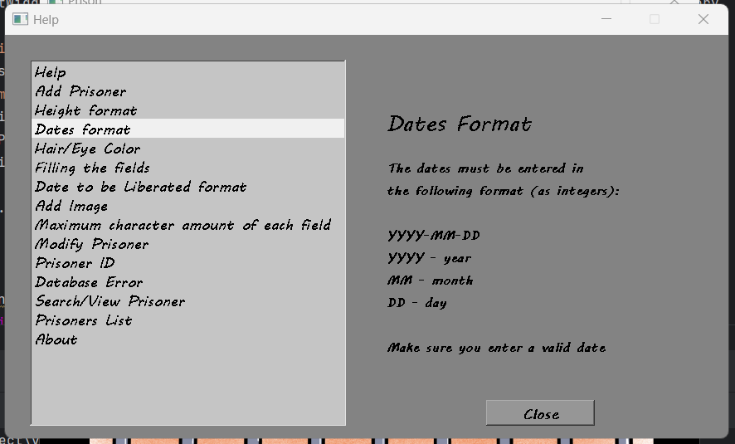
Help
Inside this option you will find things like:
Help
About
These options should help you to understand the app better and help if you ever find yourself in need.

Slide 11

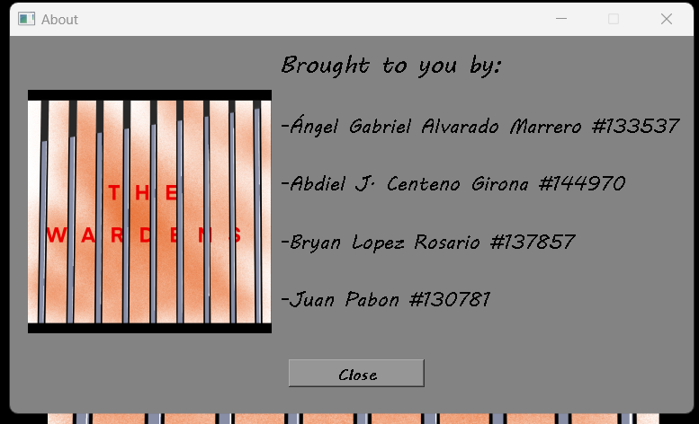
About
you can always contact us, the creators, using the ‘about’ option if you need any help.

Slide 12
END
Feel free to contact us at any time. Thank you all and see you next time.

